Slide 1
Team 254 FRC 2018
Software Engineering

Slide 2
Agenda
Objective of this presentation
Project Information
Project Schedule
Project Team / Roles and Responsibilities
GitHub
Organizing your design using Sequence Diagrams
Goals

Slide 3
Objective of this Presentation
Provide a place to consolidate and summarize important project information needed by the Software team such as:
System Architecture
Software Architecture
Software Design
Resources
Tools
Team member roles and responsibilities

Slide 4
Project Information
Project description: https://www.firstinspires.org/robotics/frc/game-and-season
Add more later…

Slide 5
Project Schedule
FIT District Austin Event (Qualifying Event)
MAR 1 - MAR 3 2019
FIT District Dallas Event (Qualifying Event)
MAR 29 - MAR 31 2019
Add more later…

Slide 6
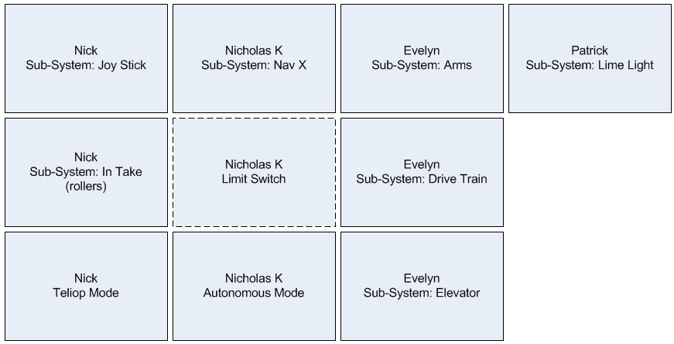
Project Team / Roles and Responsibilities
In order to complete all the Software Development on time, the work must be divided up among the team.
This diagram captures who is responsible for developing the software for each major area

Slide 7
GitHub
What is GitHub?
GitHub is a web-based service for version control using Git. It is mostly used for computer code. It offers all of the distributed version control and source code management (SCM) functionality of Git as well as adding its own features.
Why should we use GitHub?
GitHub allows you to save and keep track of versions of your software on a computer system that is accessible anywhere there is an Internet connection and is backed up.
Saving your code in GitHub will increase the chances of not losing any valuable working code because it was only saved on someone’s laptop.
What happens if the laptop crashes or is destroyed? All of the code for your project would be lost!
Where is our GitHub repository?
https://github.com/WarriorRobotics3676?tab=repositories
How often should I commit changes to the GitHub?
Every time you have completed a significant chunk of code
You must ensure you did not break any previously working functionality before committing your new changes.

Slide 8
Organizing your Design Using Sequence Diagrams
What is a Sequence Diagram?
A sequence diagram is a good way to visualize and validate various runtime scenarios. These can help to predict how a system will behave and to discover responsibilities a class may need to have in the process of modeling a new system.
A sequence diagram shows object interactions arranged in time sequence. They're also called event diagrams. It depicts the objects and classes involved in the scenario and the sequence of messages exchanged between the objects needed to carry out the functionality of the scenario.

Slide 9
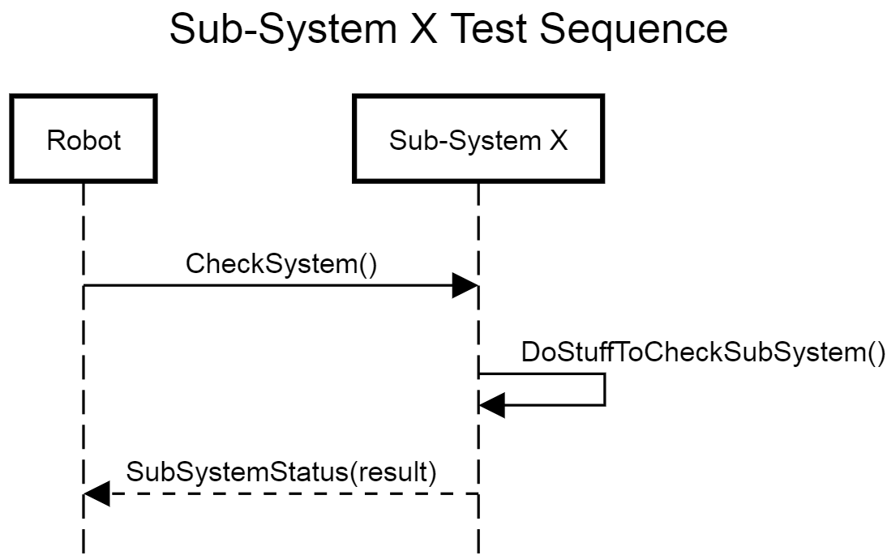
Sequence Diagrams
How do I draw a Sequence Diagram?
A sequence diagram represents each object needed to carry out the functionality of the scenario as parallel vertical lines called lifelines.
The messages exchanged between the objects, are represented by horizontal arrows between the objects in the order in which they occur.
Basic Example:

Slide 10
Sequence Diagrams
So how do I apply Sequence Diagrams to FRC 2018?
Use them as a tool to help you break down the Functions the Robot needs to perform.
Breaking down a higher level Functional into smaller chunks will help you understand step-by-step how the Robot will perform the Function
Knowing each individual step required will help you define what each Java Class will need to do.
The first thing you need to do to get started is make a list of all the Functions the Robot needs to perform
See some examples on the next slide

Slide 11
Sequence Diagrams
Example Robot Functions
Low Level Function examples
Raise elevator to position X
Drive forward 10 feet
Drive in a circle
Test Sub-System X
High Level Function examples
Place Hatch while in Autonomous Mode
After you’ve identified all of the Functions the Robot needs to do, create Sequence Diagrams for each Function.
Note: when you get to the Low Level Sequence Diagrams, each of the horizontal lines (messages) between Objects should map to a Class ‘Method’ in the code. This tells you the list of methods that each Class needs to implement.

Slide 12
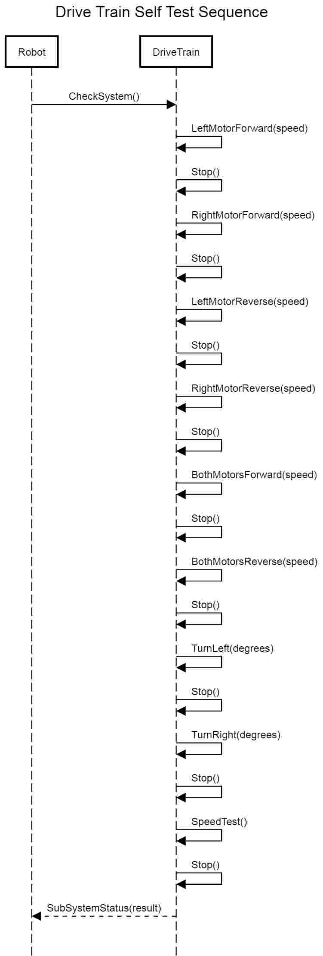
Drive Train Self Test Sequence

Slide 13
Sequence Diagram Tool
Use this free online tool to create your Sequence Diagrams
http://sequencediagram.org/
The tool works by allowing you to create Sequence Diagrams visually or in script (text).
You can ‘Save’ your Sequence Diagram by saving the script (text) you see on the left hand side of the screen
When you need to access your Sequence Diagram later for viewing or further editing, simply copy-paste your previous script (text) back into the box on the left hand side of the screen.
Try it yourself…here’s how
1: Click on the link above to get to the tool, or copy-paste the link into your Internet Browser.
2: Copy-paste the script (text) from the box below into the box on the left hand side of the screen in your Internet Brower.
3: The tool should now look like the Sequence Diagram example on the previous slide.
Note: I recommend that each Sequence Diagram be saved off as a separate text file so we can save (commit) them in the GitHub repository
title Sub-System X Test Sequence
Robot->Sub-System X:CheckSystem()
Sub-System X->Sub-System X:DoStuffToCheckSubSystem()
Robot<--Sub-System X:SubSystemStatus(result)

Slide 14
Software Development Plan
Requirements Analysis – understand what the Robot and all of it’s subsystems need to do
Design – figure how what software needs to be written in order to meet all of the requirements
Use Cases and Sequence Diagrams are good to help you think through this
Implementation – write your new code
Write small chunks of code that you can test along the way. Test often to build confidence in the quality of your code.
The first thing you should code is test code to make sure each subsystem can perform it’s basic operations/functions.
Once these basic operations are in place, you can chain them together to create more complex Robot commands like Autonomous Mode.
Integration – make sure your new code runs with the existing code and the hardware
Test – test your software to make sure it meets all of the requirements

Slide 15
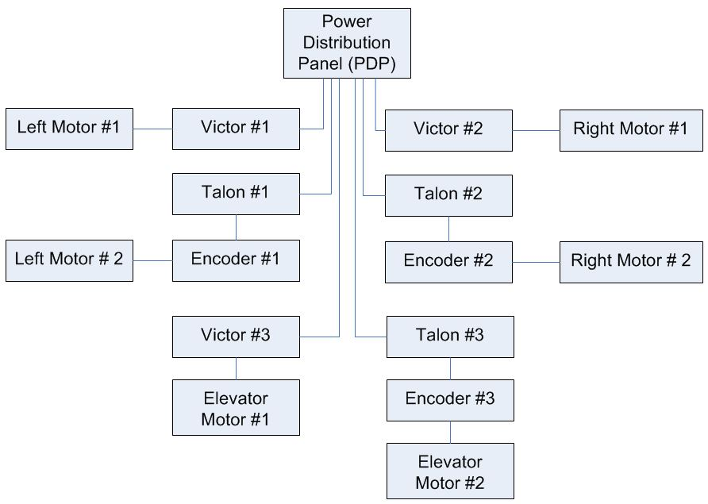
Hardware Architecture

Slide 16
Goals
Complete Joystick mappings by end of Saturday 2/9/19
Complete Test code for each Sub-System by the end of Sunday evening 2/10/19
Priority items
Fully functional Drive Train
Fully functional Joy Stick
Fully functional camera (no tracking, just vision)
Ability to control elevator to 6 preset heights (heights don’t have to be right, they just need to be 6 different heights)
Complete Teliop Mode basic controls by end of Tuesday 2/12/19
Complete first draft of autonomous mode by end of Wednesday 2/13/19
Continue to refine functionality … add more details later…

